Slide 1

TradeTrendz
Alex, Neya, Shadrack
FinTech 2023

Slide 2
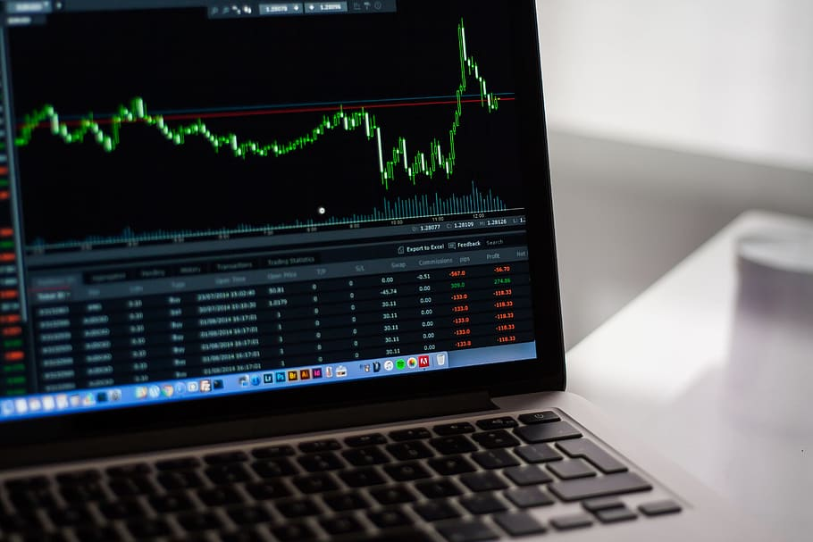
For most, with a full-time job, there is minimum time to watch the stock market until it moves in their desired direction?

Slide 3
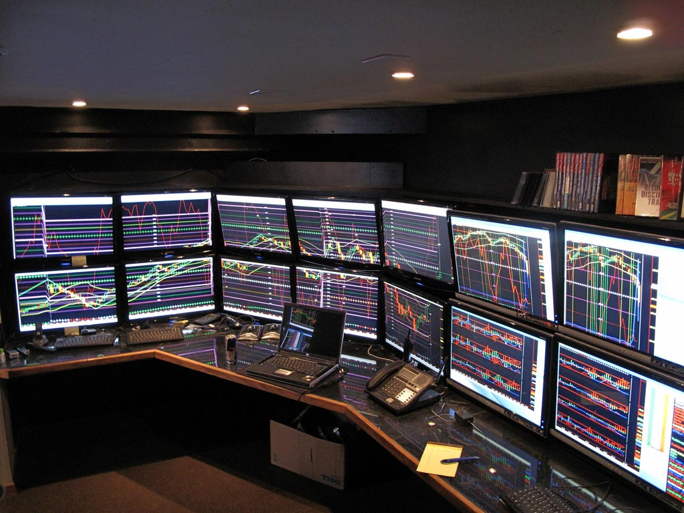
Our Motivation – No hands attached profit!
Trends to predict the stock price.
Models to access the efficiency.
Breakouts that allows stock selection for your type of trade Buy or Sell:
Stocks
Options
An App to make it Seamless!
This Photo by Unknown Author is licensed under CC BY-SA

Slide 4

Trading Algorithm Philosophy
Use TA-Lib for calculations
Technical Analysis – Bollinger Bands, Keltner Channels, RSI, MFI
Conservative parameters/less trades but high win rate
Compensate for low trades with high-risk amounts

Slide 5
Trading Algorithm Logic
Finding a Balance
Risk: 40% on our portfolio
Stop Loss: 15%
Buy Condition:
If statement: RSI < 20 and price is below lower Keltner or price is below lower Bband
Sell Condition:
If statement: RSI > 80 and price is over upper Keltner or > over upper Bband or MFI < 57 and RSI is > 80 or stop loss condition met.

Slide 6
Results:
Applying to NASDAQ Stocks: Win Rate
Out of 50 stocks analyzed:
28 had over 80% WRP (16 having 100% WRP)
AVG Profit/Loss = +3-5% (over past 2 months)
This Photo by Unknown Author is licensed under CC BY-SA

Slide 7
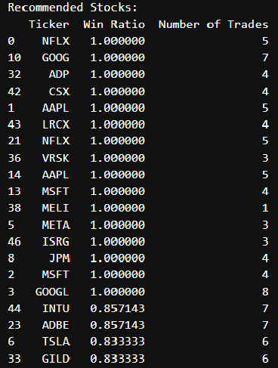
Stock Selector
We have a working algorithm, but now what, how do we know what stocks to use and which ones to avoid?
Creation of a stock selector that can analyze 50+ stocks using our algorithm to determine which have the highest historical performance and the number of trades the algo would have entered into over a given period.
Helps inform us of our stock choices and reduces risk.
Implement trading algorithm condition logic to stock selector to make it applicable specifically to what criteria we are trading on.
Prints out recommendations based on Win Percentage and Number of Trades

Slide 8


Challenges for Alex
Challenges –
Determining the proper conditions to be successful
What TA indicators to use
Implementing the same trading logic into the stock selector as the trading algorithm to return the same results.
Limited free historical data
Success –
Overall, the for the 2 month back test our algorithm performed really well.
Stock selector indicated stocks that it would do well with, and running the back test confirmed results.

Slide 9

Shadrack Random Forest Model

Slide 10
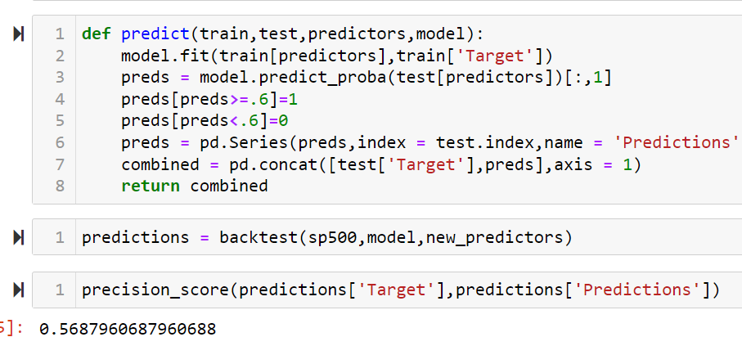
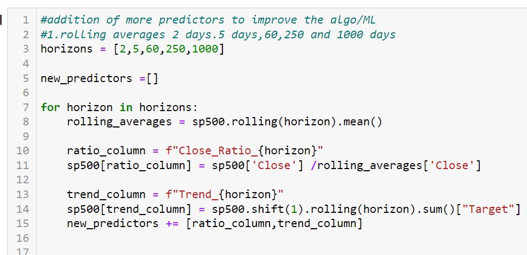
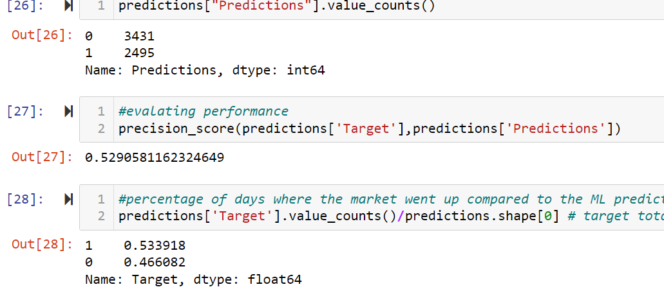
Random Forest Model

Slide 11

Shadrack N.
Challenges – Correlate data with other indices to sp500 index. Trying to use hourly data and factor in macroeconomic environment.
Successes – Increase of TA and financial parameters increased accuracy.

Slide 12

Neya
Breakout –
Keltner Channels
XGBoost Model

Slide 13
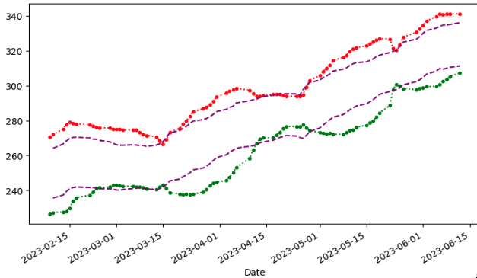
Keltner Channel
Breakout
Breakout
Breakout

Slide 14
Neya _ Challenges & Success
R2 represents the proportion of variance for a dependent variable(s) Changes in the dependent variables explained in the independent variable.
R2 range from 0 to 1
MSE – measure of how close a fitted line to its actual data points. What is considered a good MSE widely depends on the scale of the target.
Working with regression models like XGBoost – you shouldn’t use MSE or R2 metric alone.
Challenges – I desired to receive a forecast of stock price data from XGBoost model. I learned that it’s not possible, but what is possible is to do a future forecast of features.
Success – Received High Accuracy on XGBoost Model.
Zillow (Z), MSE = .3 r2 = .98
Microsoft(MSFT) = MSE = 43.48, r2=.90

Slide 15

Summary:
No emotions attached.
Minimize risk.
Removes the need to Date our stocks.
This Photo by Unknown Author is licensed under CC BY-SA

